Slide 1
Data 1202 – Halloween Viz Assignment by Raj Dholakia
Trick or treat?

Slide 2
Data Preparation
The Halloween Viz dataset used to create the dashboard is created by Jeffrey A. Shaffer, a resident of Cincinnati.
The dataset is contains the candies given out by Jeffrey on Halloween every year. The data is recorded at an interval half an hour between the trick-or-treat timings (6 to 8 p.m.). The new dataset contains data from 2008 to 2020.

Slide 3
Data Preparation (Continued)
This dataset is simple and can can be combined with other external datasets to provide better insight into the trick-or-treat figures. I will be considering Kaggle's IMDB horror movies dataset and IMDB's Dataset to build an insightful Dashboard.
The number of movies/TV series released between 2008 and 2020 will be considered for the visualization, as the Halloween Viz dataset also contains the same years’ data.
The relationship between the number of good horror movies/TV series released and number of candies distributed in a particular can be explored.
Note: Link to GitHub Repo where the data cleansing steps are explained in detail.

Slide 4
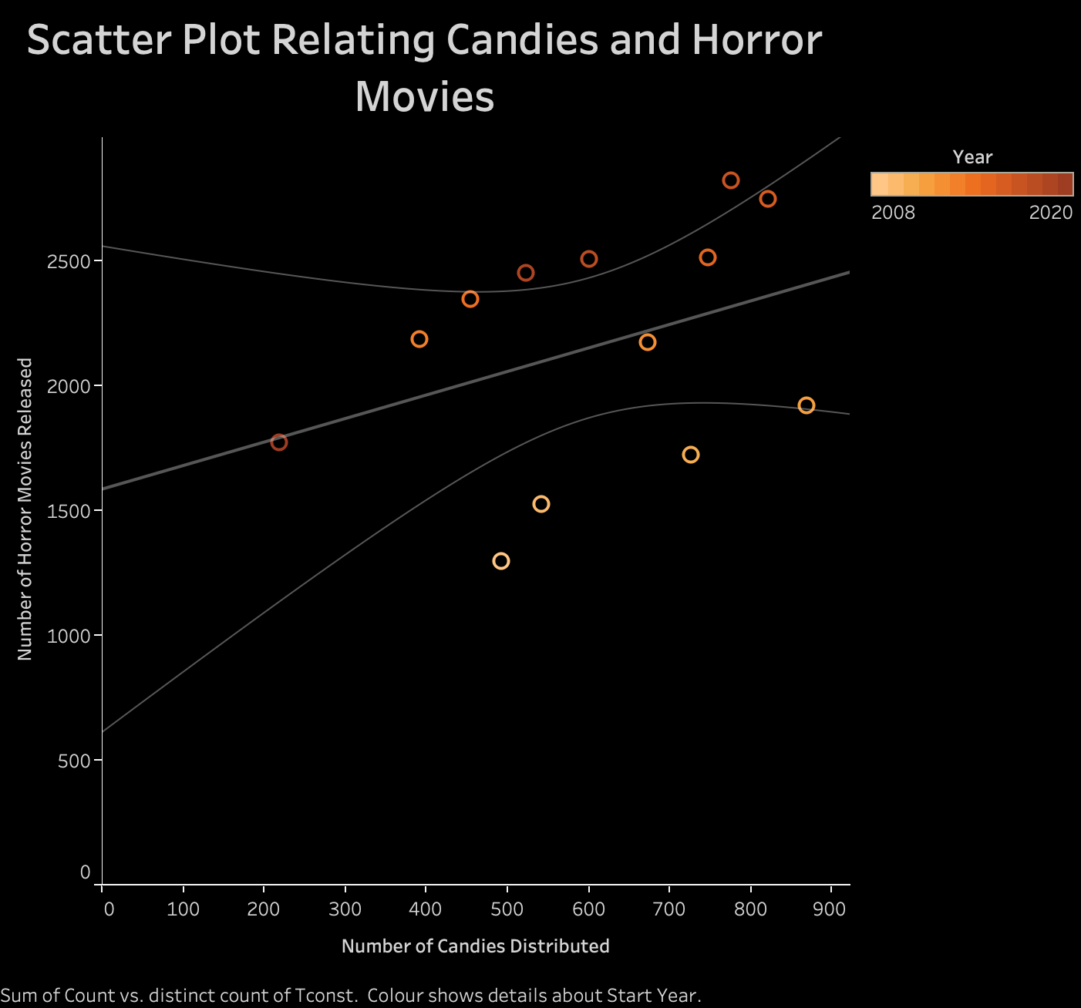
Relationship between the Horror Movies and Trick-or-Treaters
There seems to be a positive correlation between the variables.
Number of candies distributed can be affected by other variables and hence a strong relationship is not observed between the two.

Slide 5
DashBoard in Tableau
The next slide creates a static image of the dashboard created as part of the visualization assignment

Slide 6
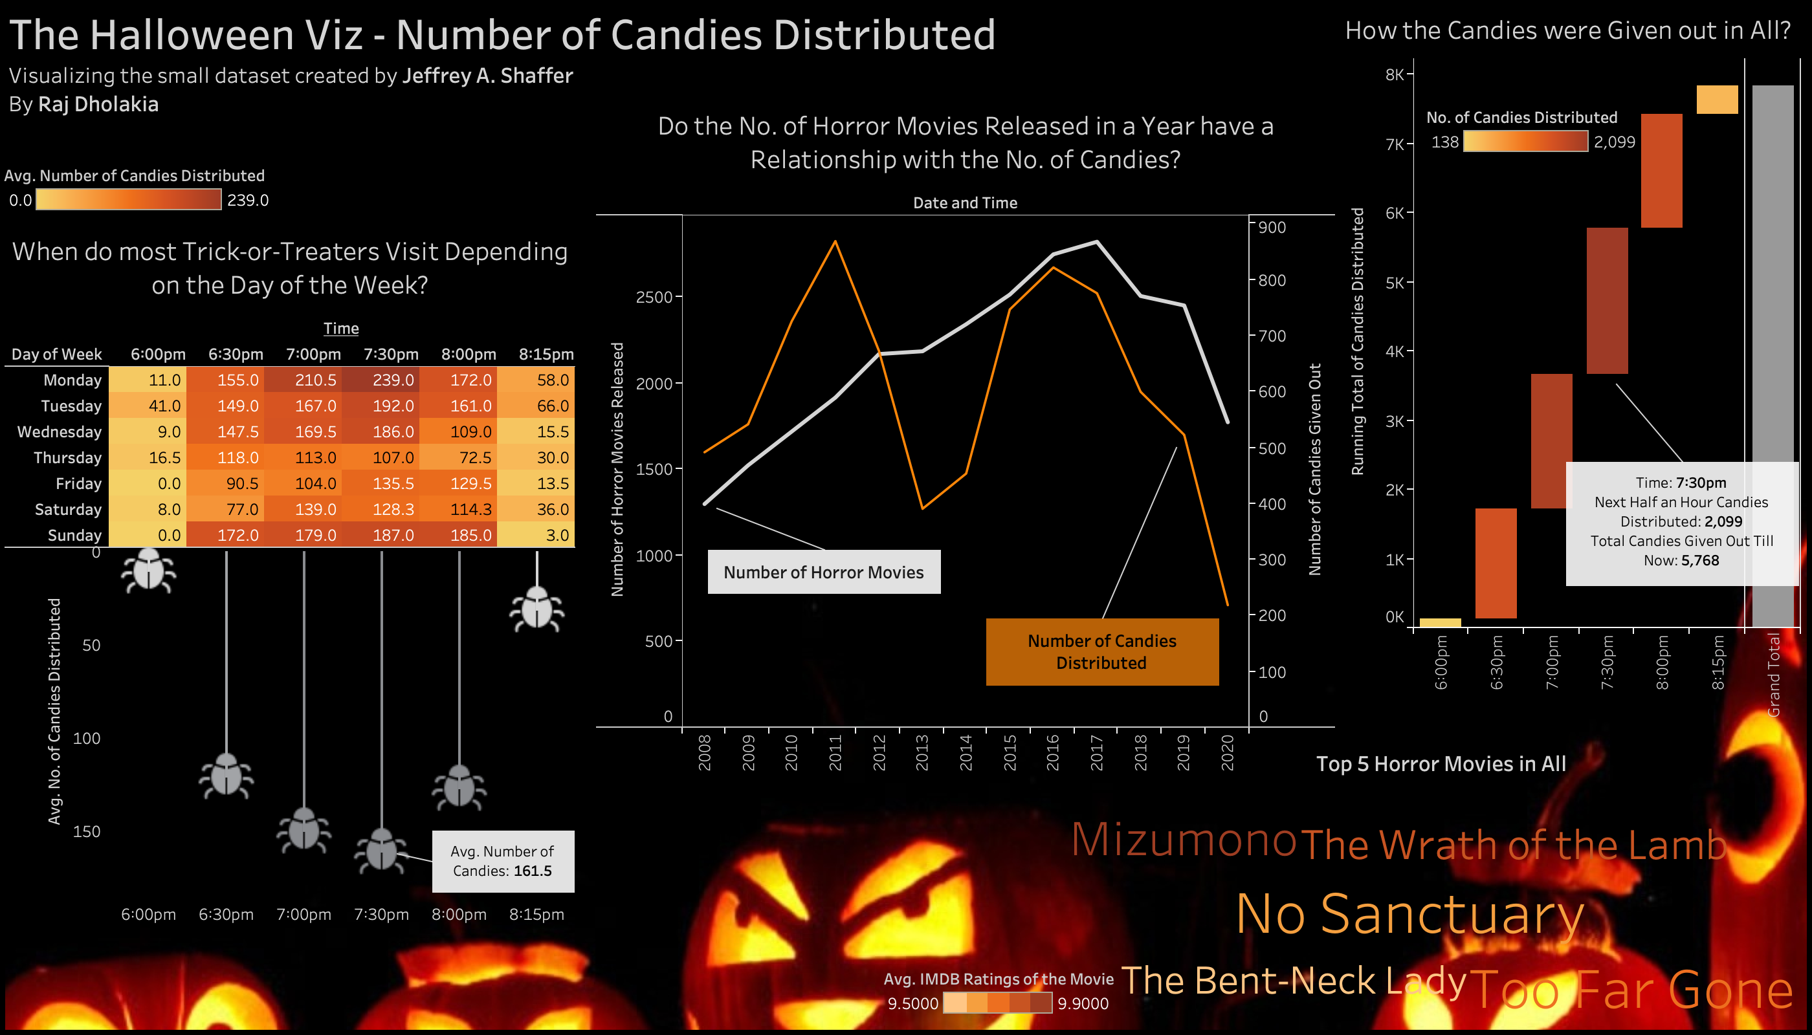

Slide 7
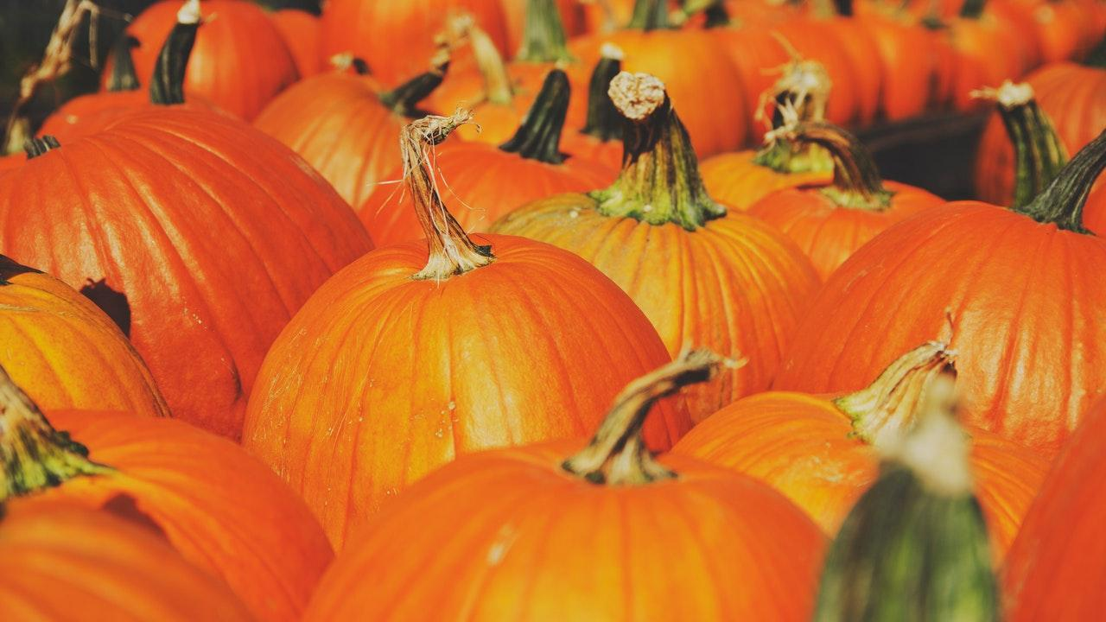
Trick or treat?
Thank you for Listening

